Slide 1
Phase 1
Implementation of the Paper’s Model

Slide 2
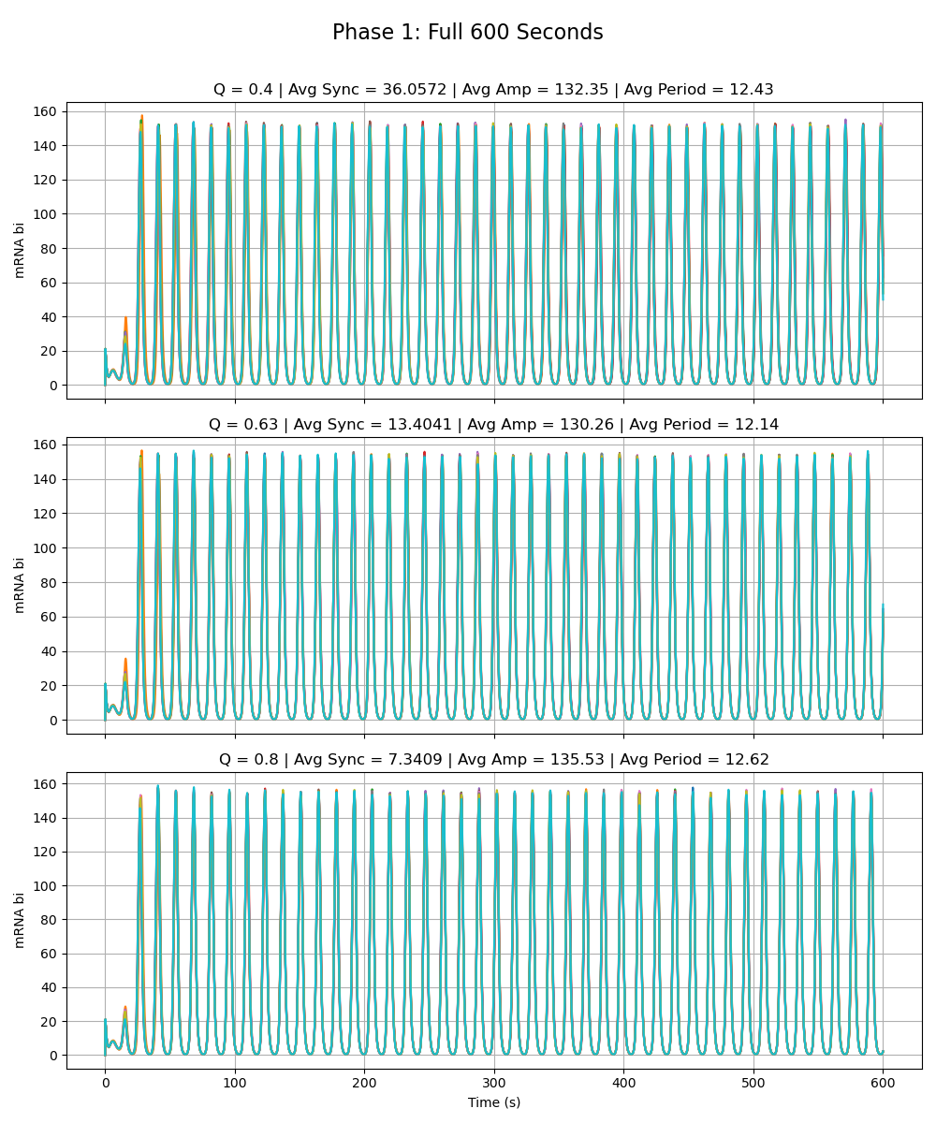
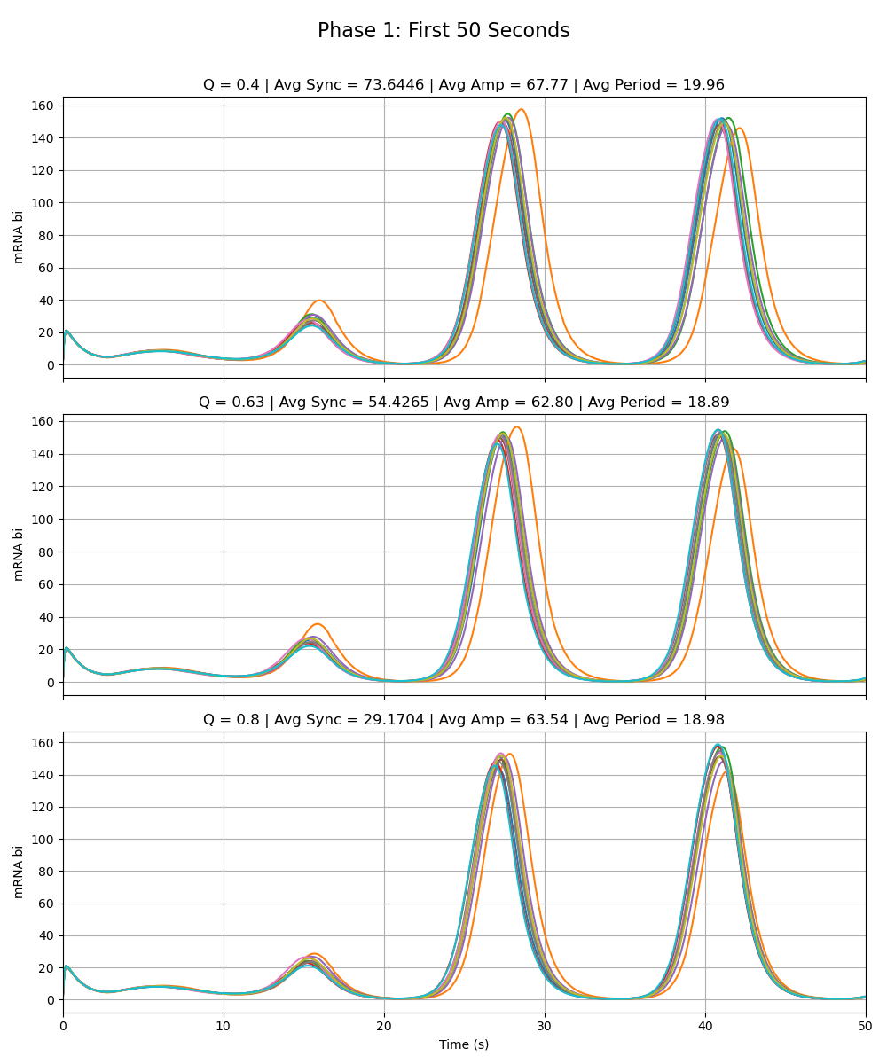
Paper’s Model
Notes:
Phase 1

Slide 3
Phase 2a – Node W
Adriana

Slide 4
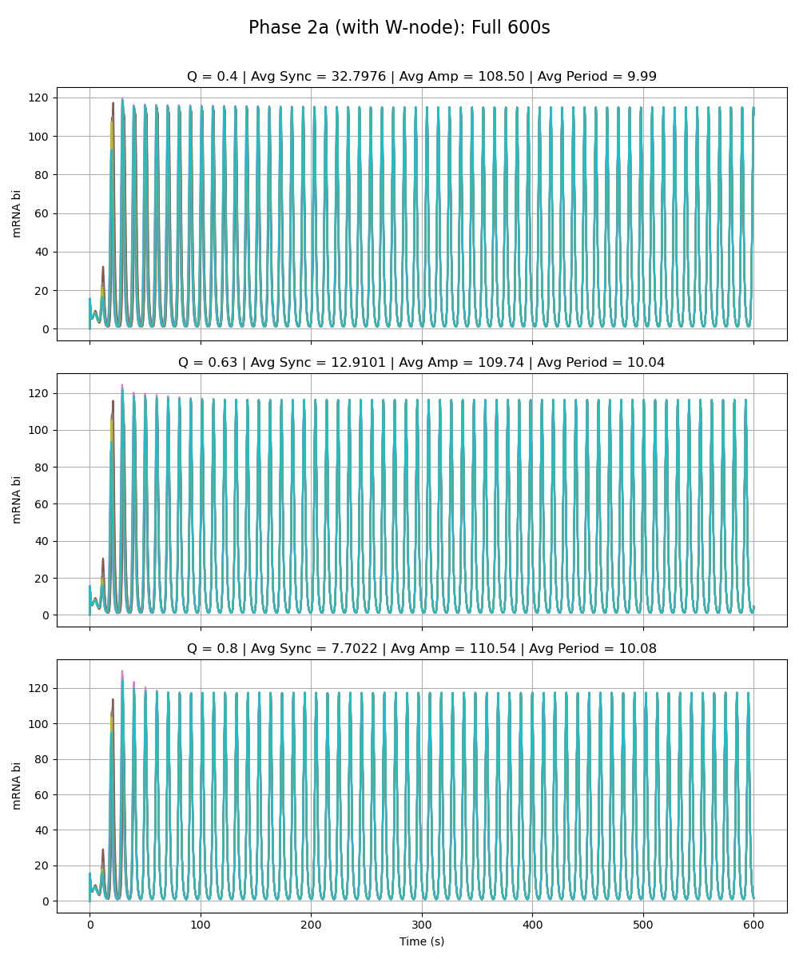
Weak Added Node
Notes:
Phase 2a – added link is very weak (max rate of w transcription is very low 0.01 vs. max rate for the rest as given by paper 216)

Slide 5
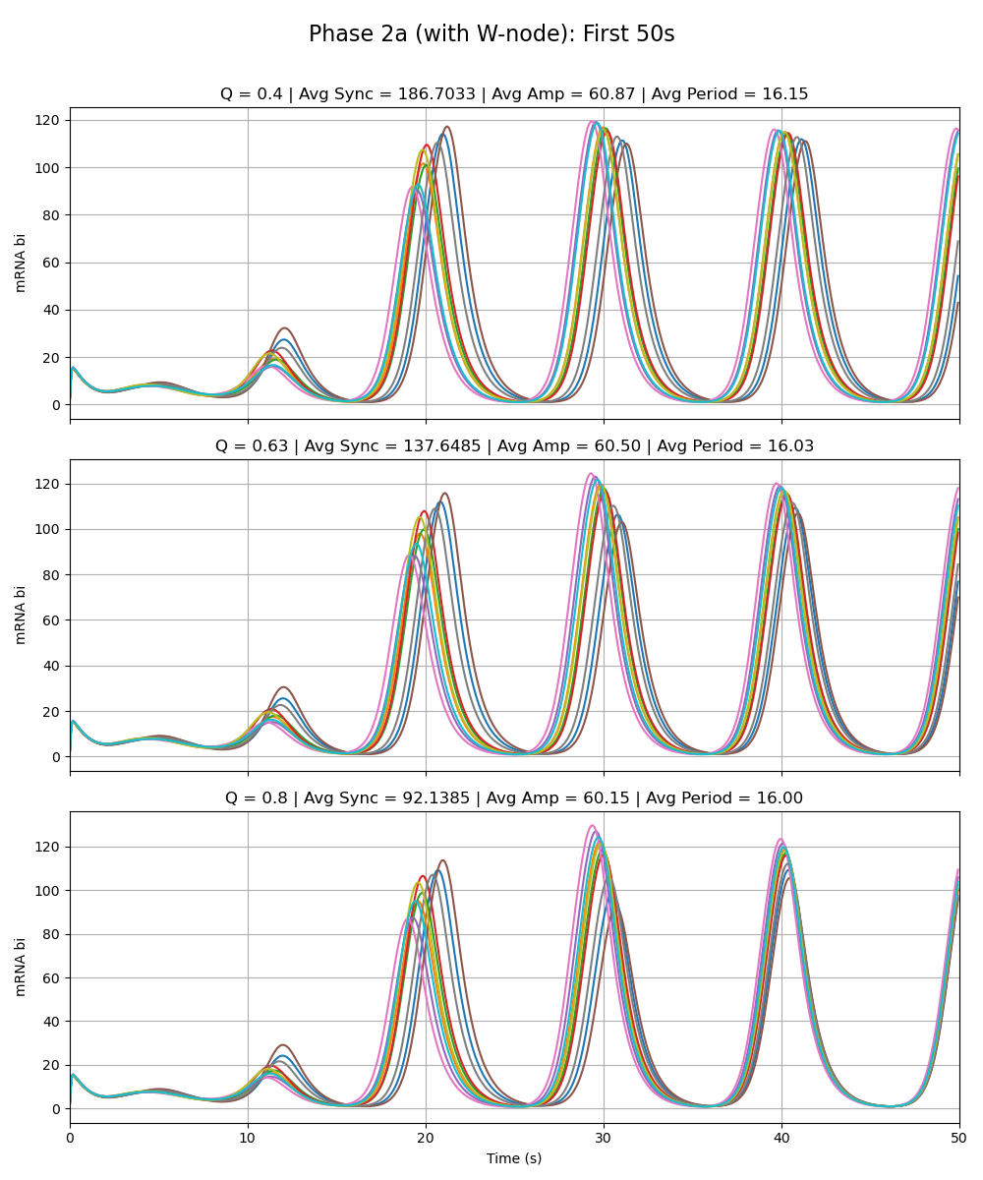
Weak Added Node
Notes:
Phase 2a – added link is very weak (max rate of w transcription is very low 0.01 vs. max rate for the rest as given by paper 216)

Slide 6
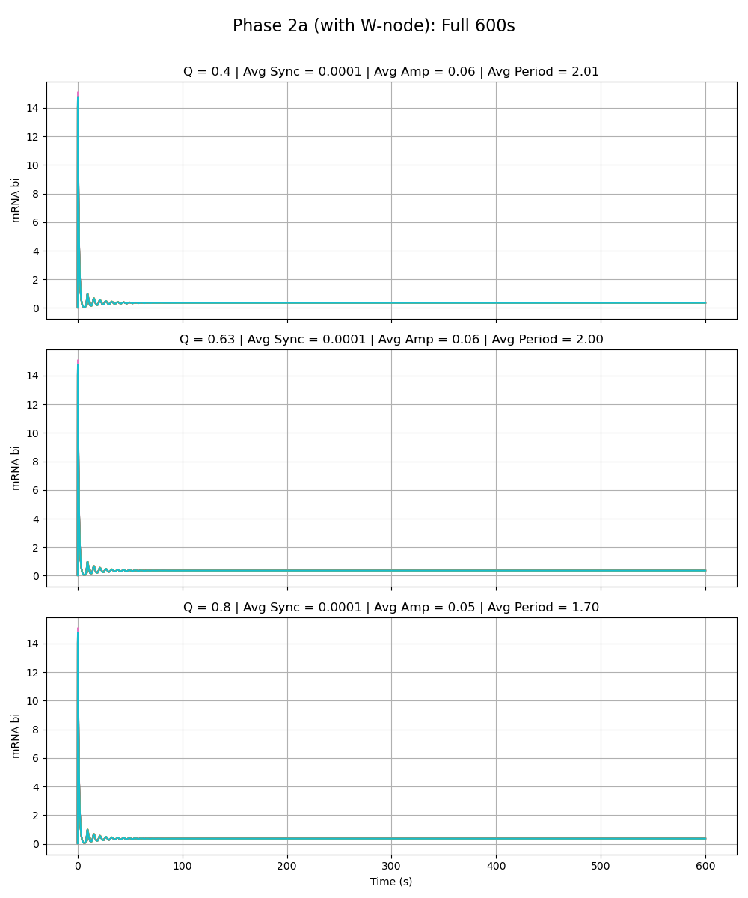
Equal Strength Added Node
Notes:
Phase 2a – added link is same strength as the rest of the circuit (max rate of w transcription is 216 vs. max rate for the rest as given by paper 216)

Slide 7
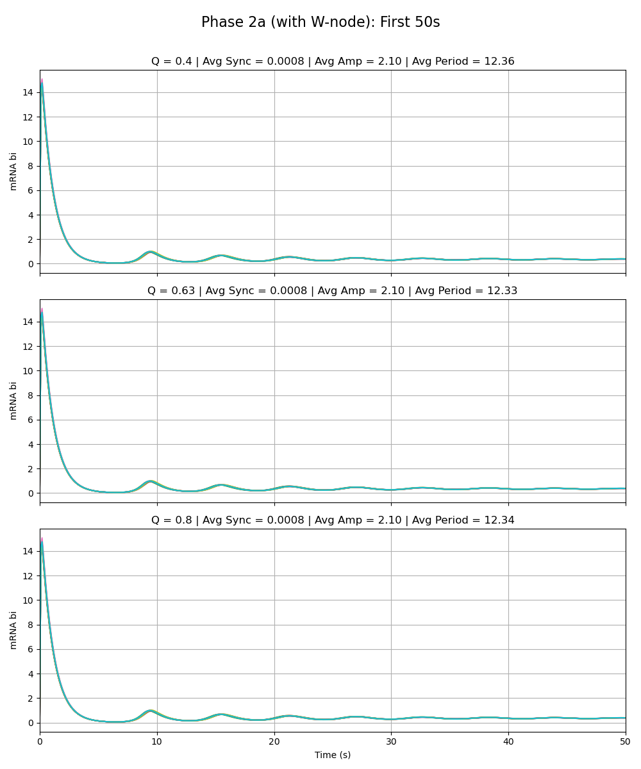
Equal Strength Added Node
Notes:
Phase 2a – added link is same strength as the rest of the circuit (max rate of w transcription is 216 vs. max rate for the rest as given by paper 216)

Slide 8
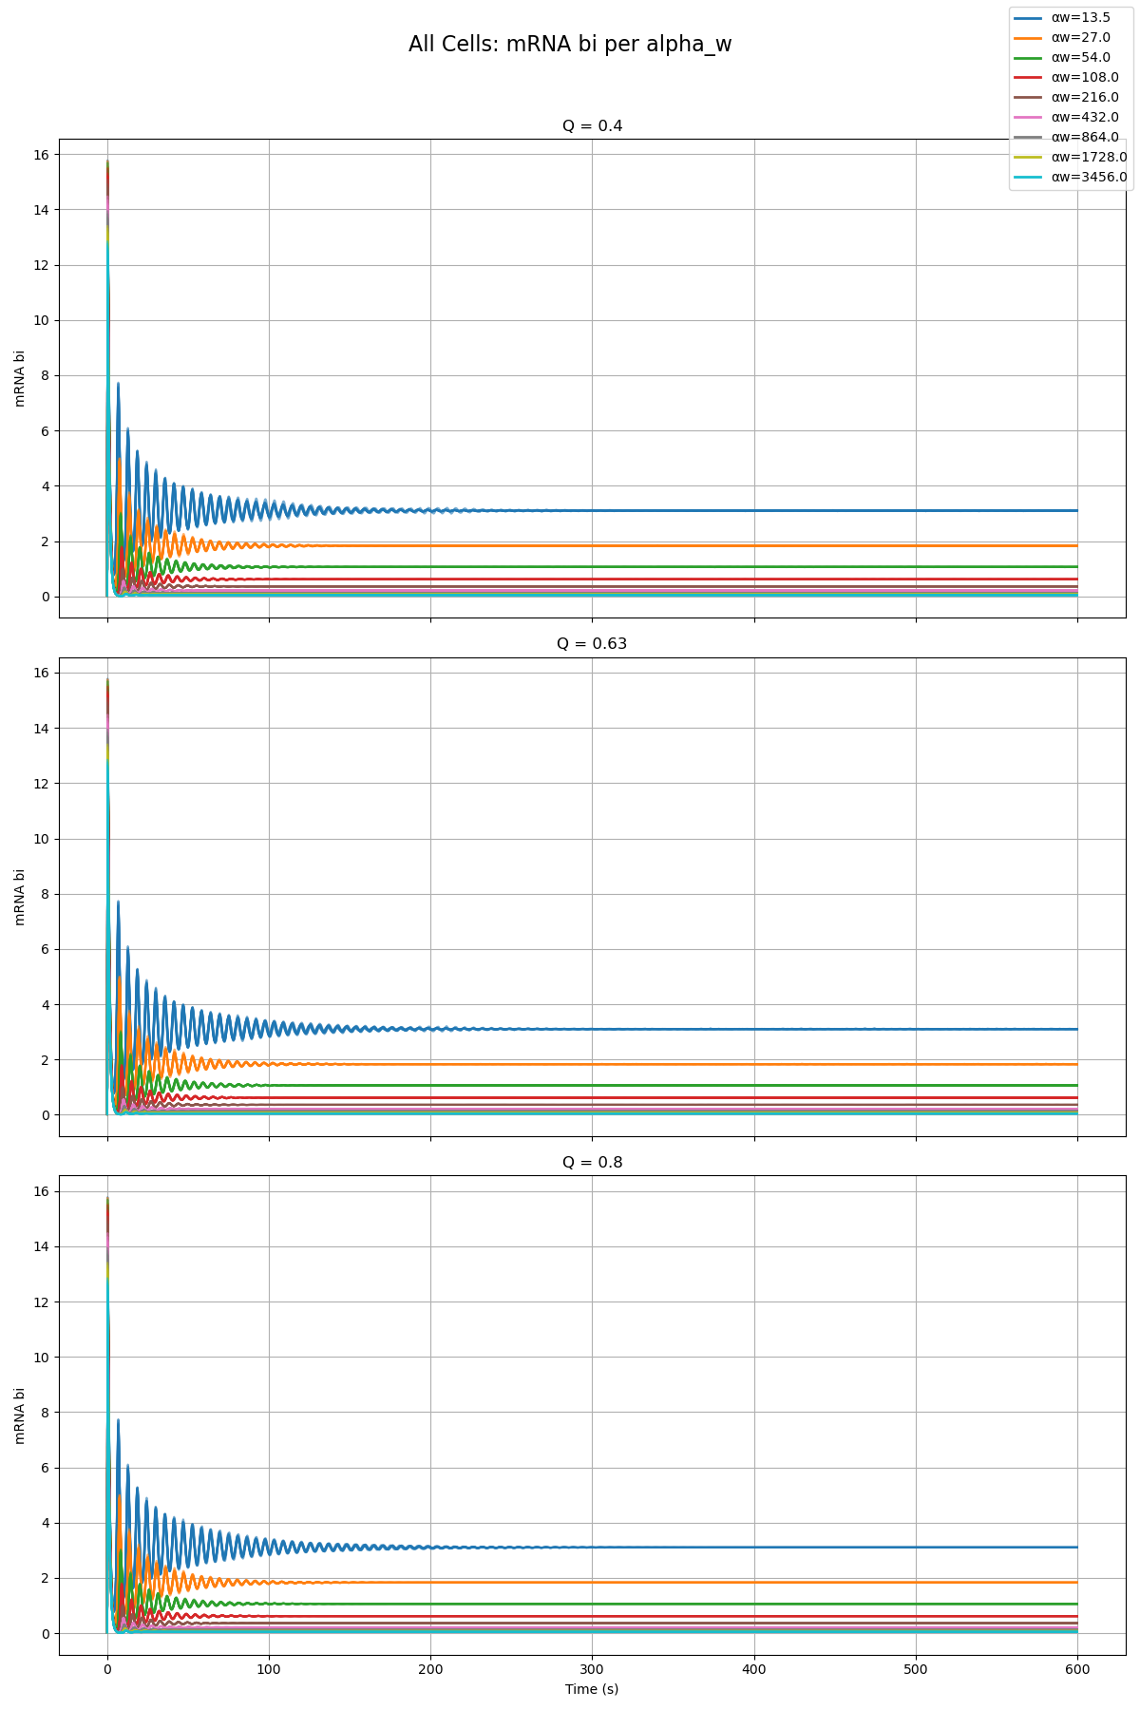
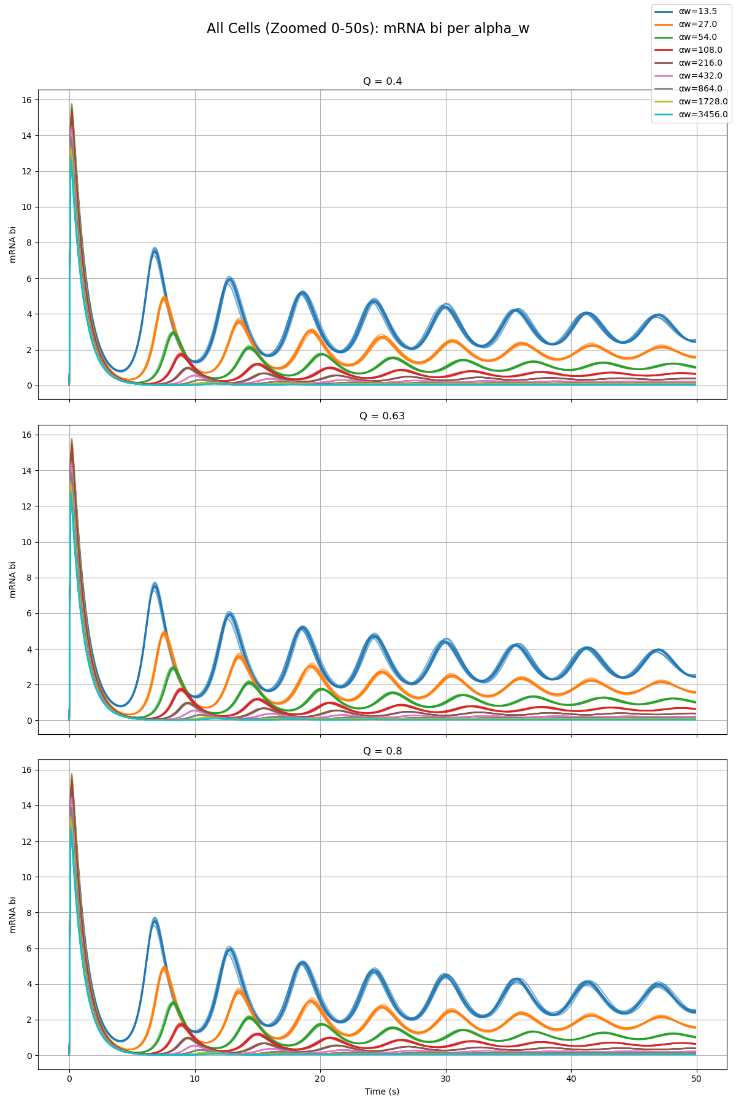
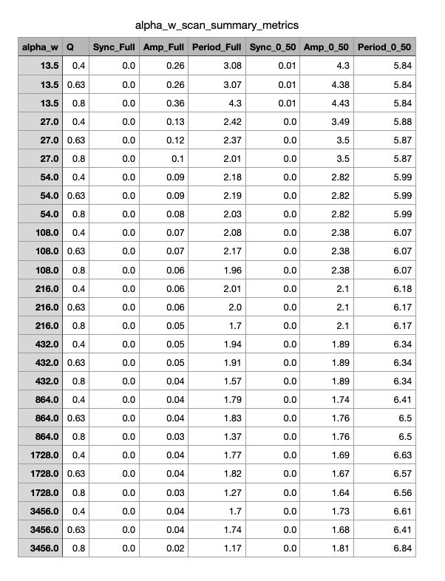
Parameter Scan

Slide 9
Phase 2a – Node X
Sydney

Slide 10
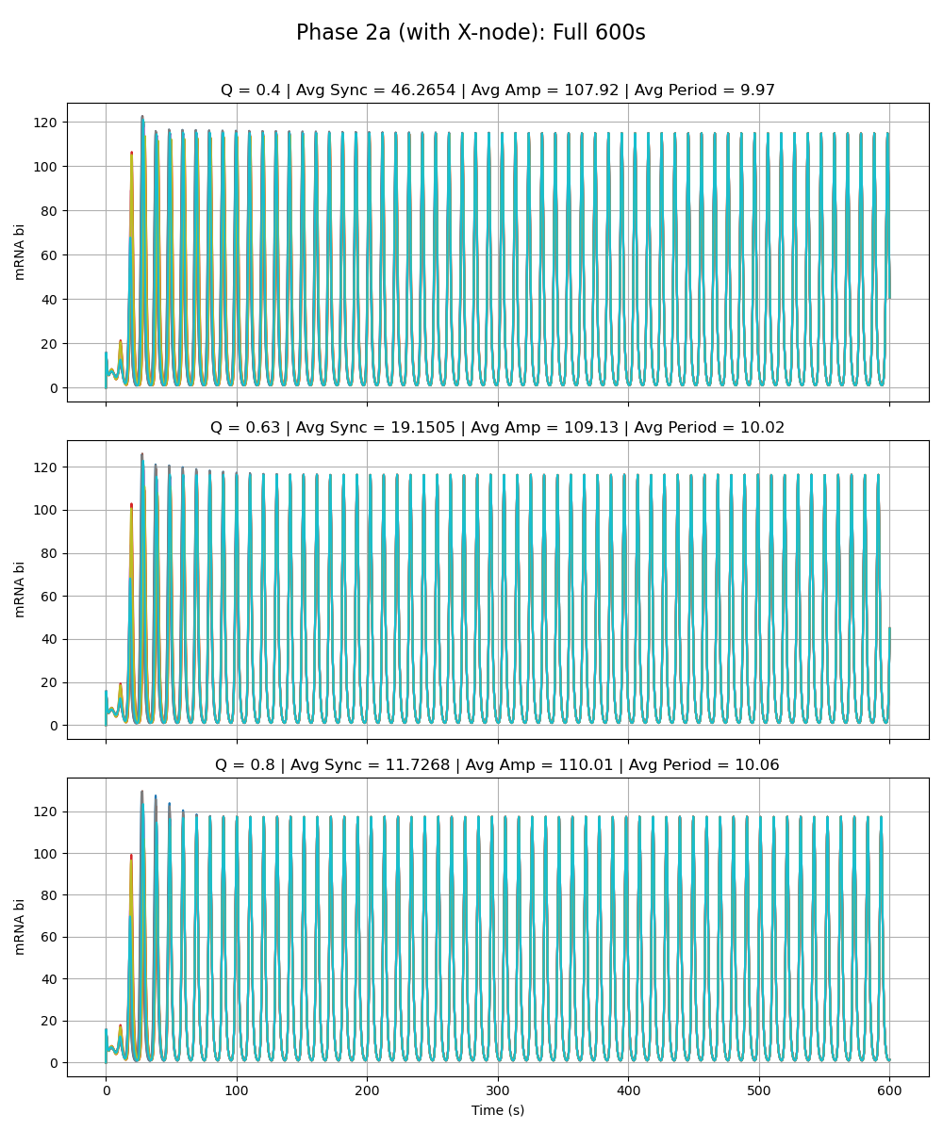
Weak Added Node
Notes:
Phase 2a – added link is very weak (max rate of x transcription is very low 0.01 vs. max rate for the rest as given by paper 216)

Slide 11
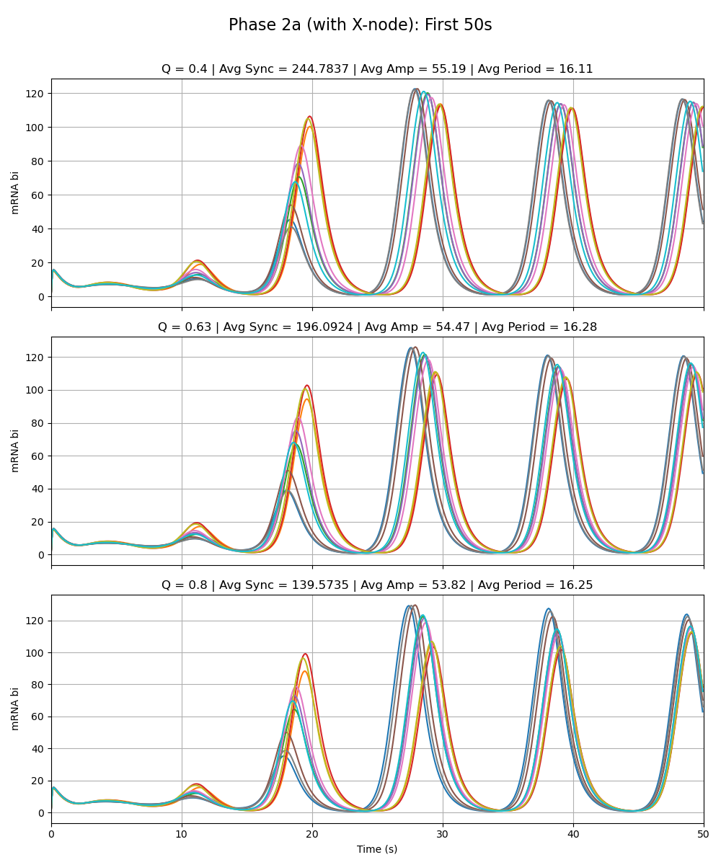
Weak Added Node
Notes:
Phase 2a – added link is very weak (max rate of x transcription is very low 0.01 vs. max rate for the rest as given by paper 216)

Slide 12
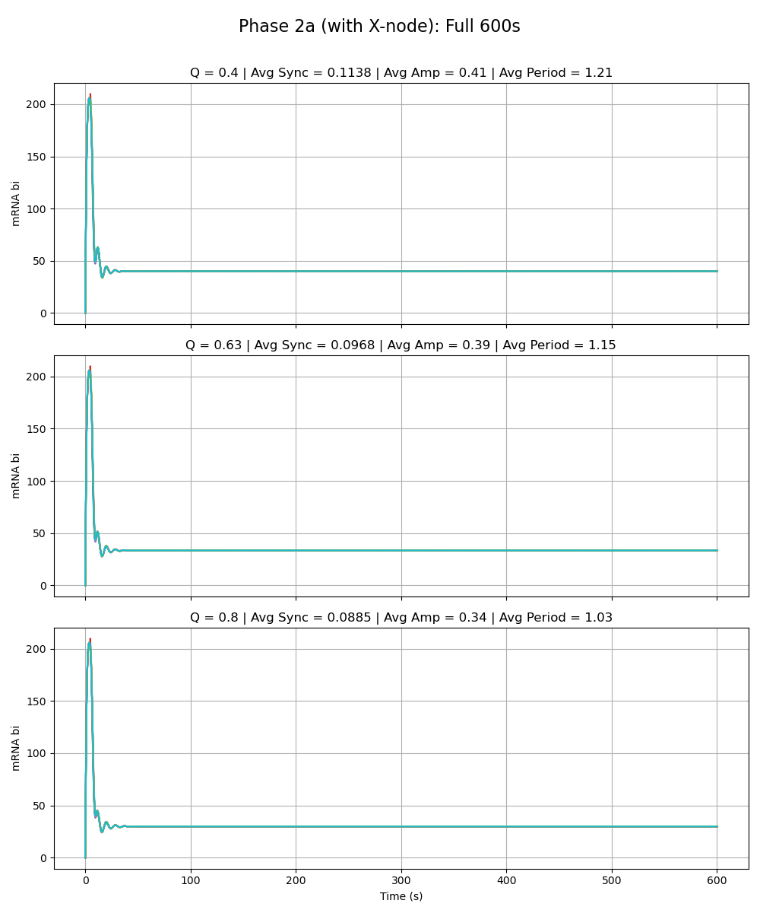
Equal Strength Added Node
Notes:
Phase 2a – added link is same strength as the rest of the circuit (max rate of x transcription is 216 vs. max rate for the rest as given by paper 216)

Slide 13
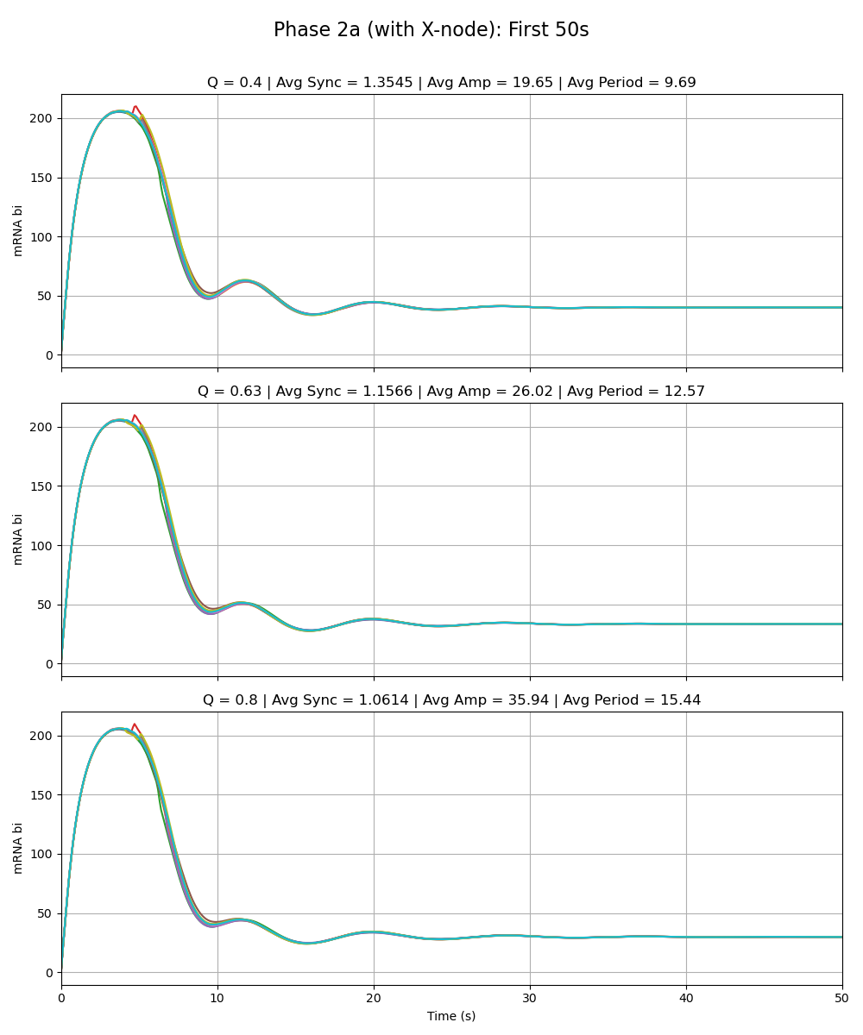
Equal Strength Added Node
Notes:
Phase 2a – added link is same strength as the rest of the circuit (max rate of x transcription is 216 vs. max rate for the rest as given by paper 216)

Slide 14
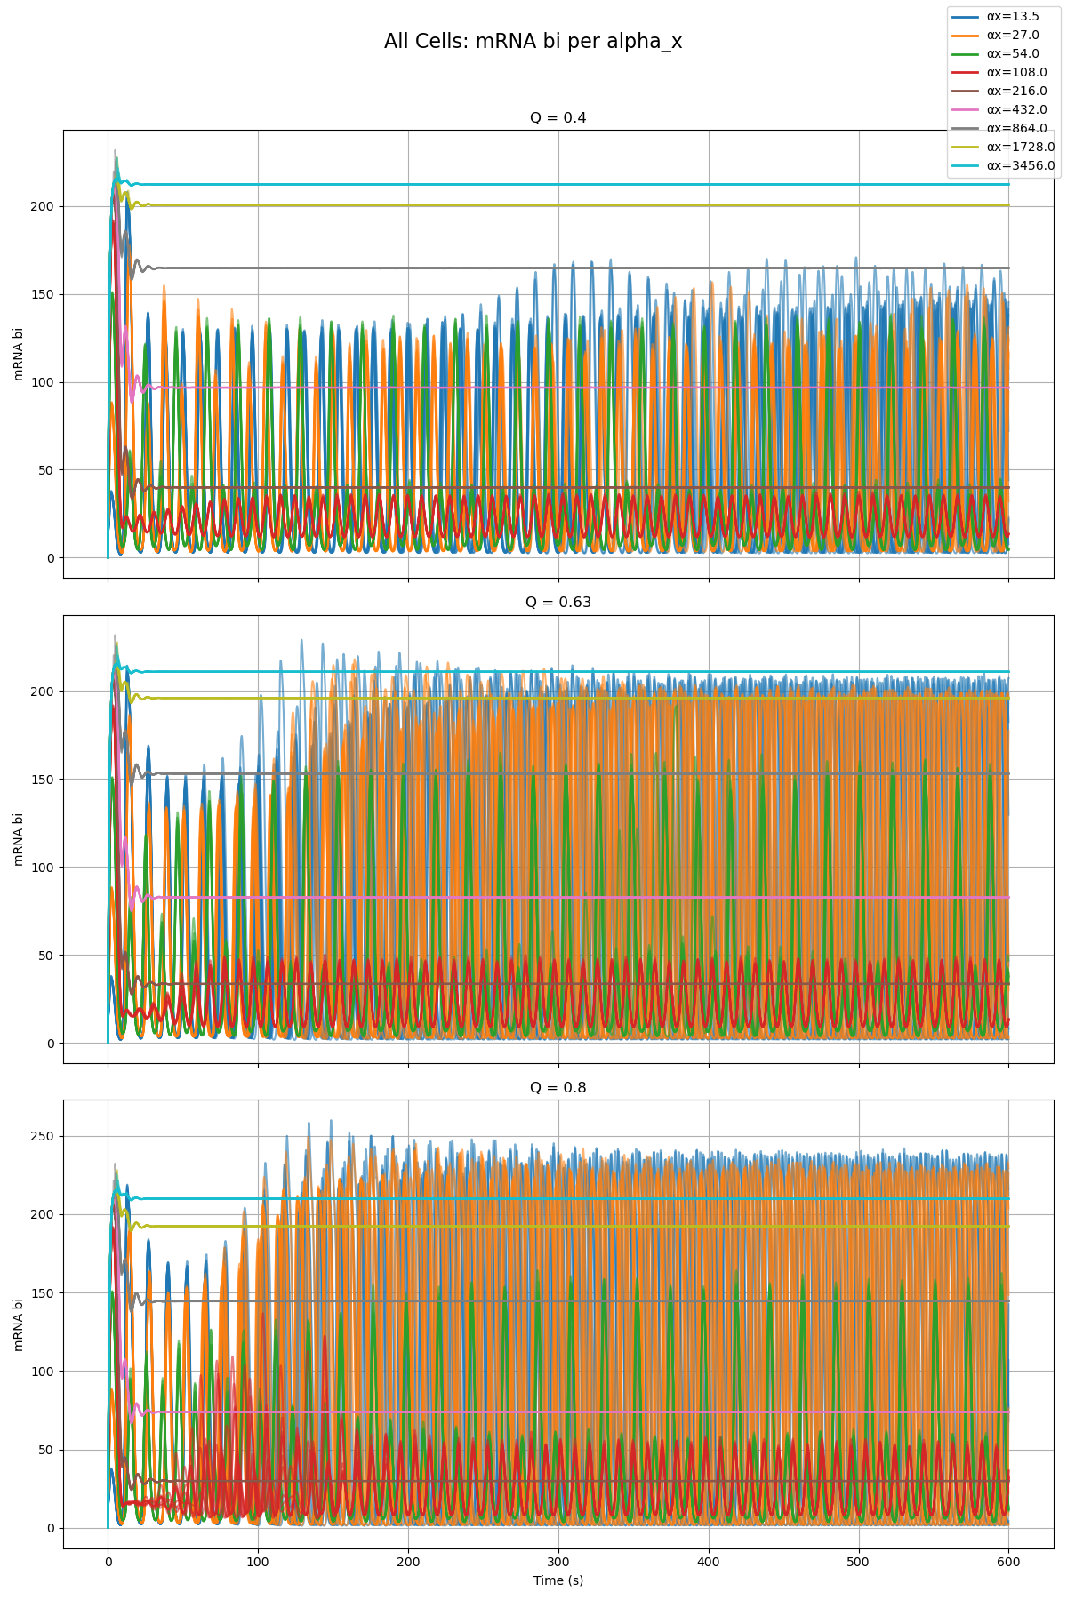
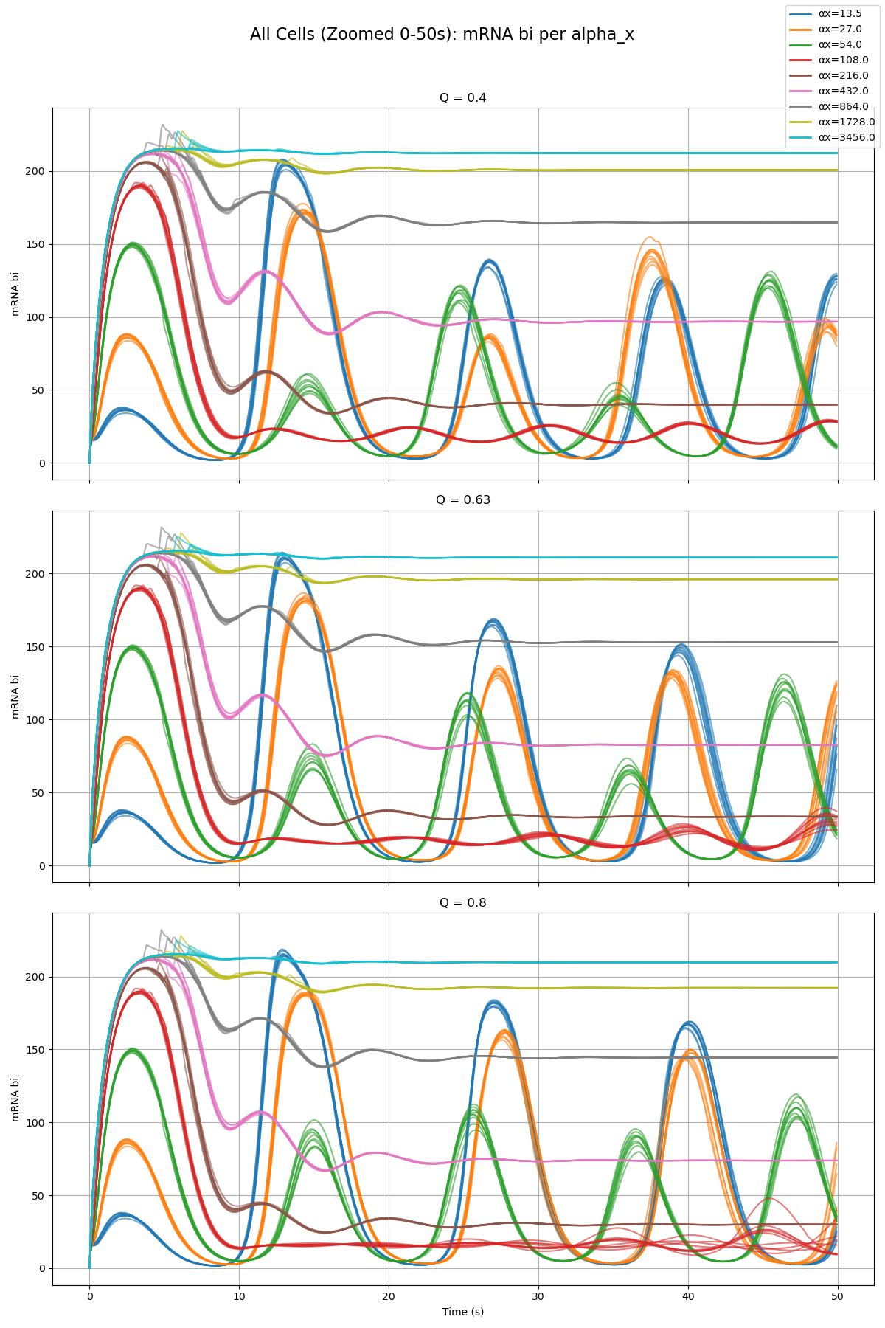
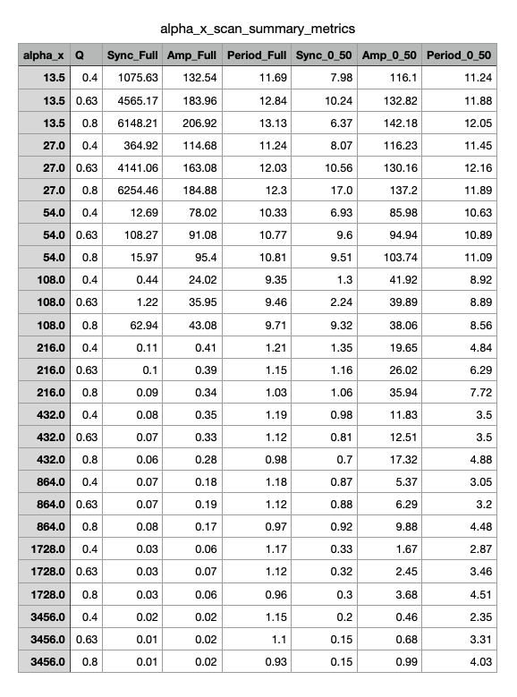
Parameter Scan

Slide 15
Phase 2a – Node Y
Sean

Slide 16

Weak Added Node
Notes:
Phase 2a – added link is very weak (max rate of y transcription is very low 0.01 vs. max rate for the rest as given by paper 216)

Slide 17
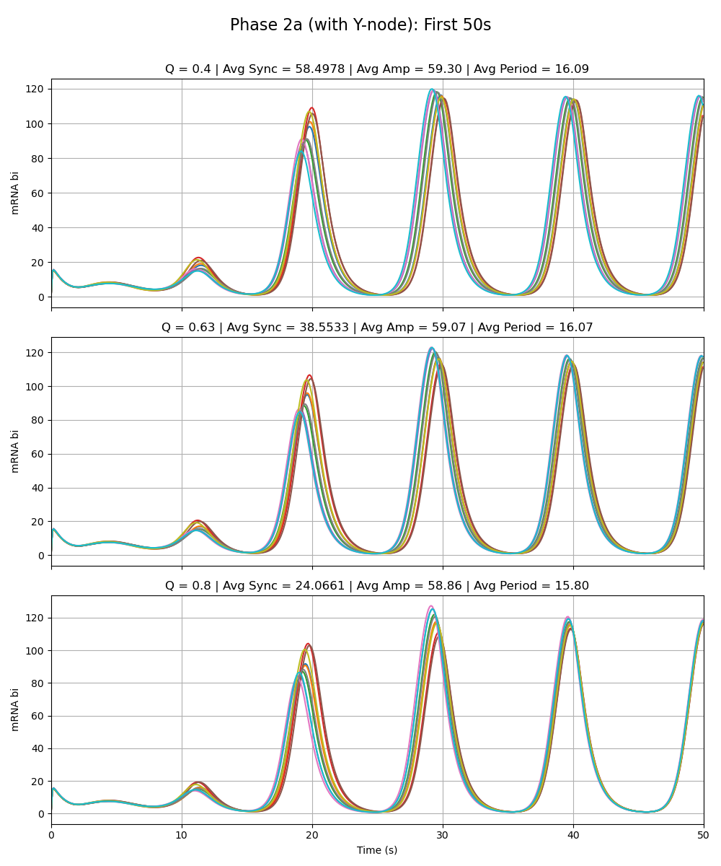
Weak Added Node
Notes:
Phase 2a – added link is very weak (max rate of y transcription is very low 0.01 vs. max rate for the rest as given by paper 216)

Slide 18
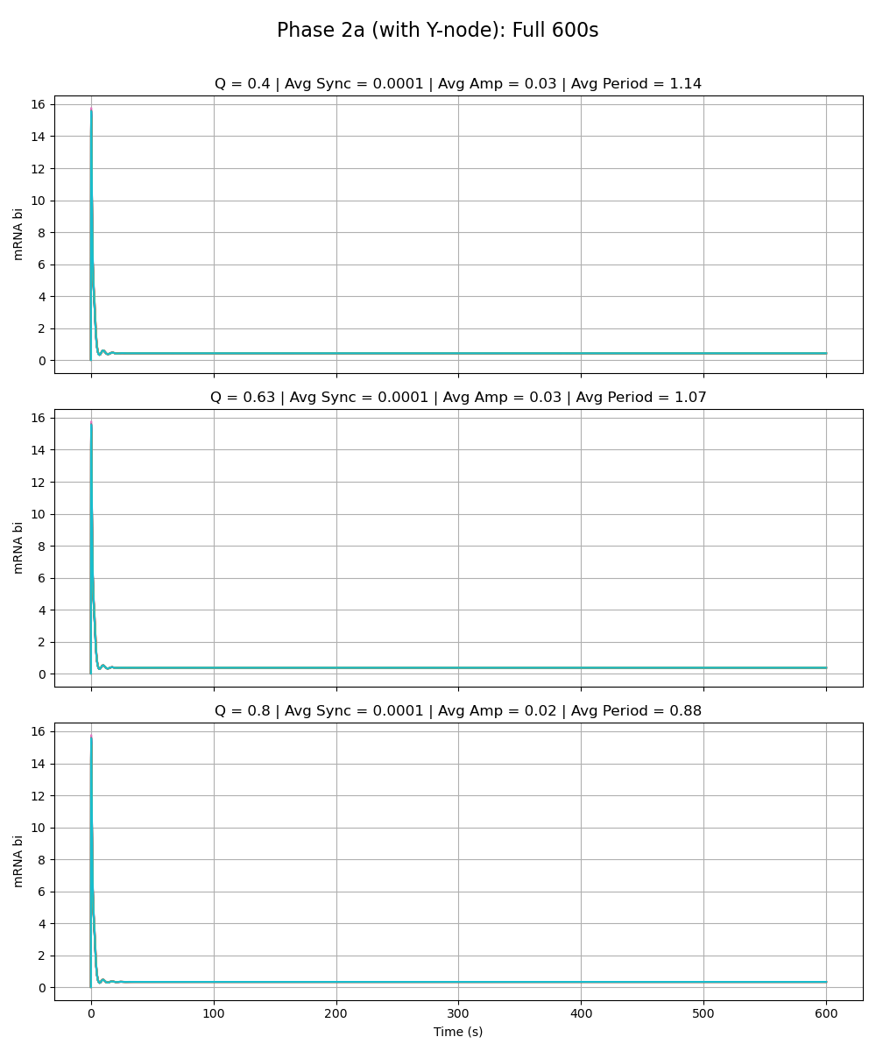
Equal Strength Added Node
Notes:
Phase 2a – added link is same strength as the rest of the circuit (max rate of y transcription is 216 vs. max rate for the rest as given by paper 216)

Slide 19
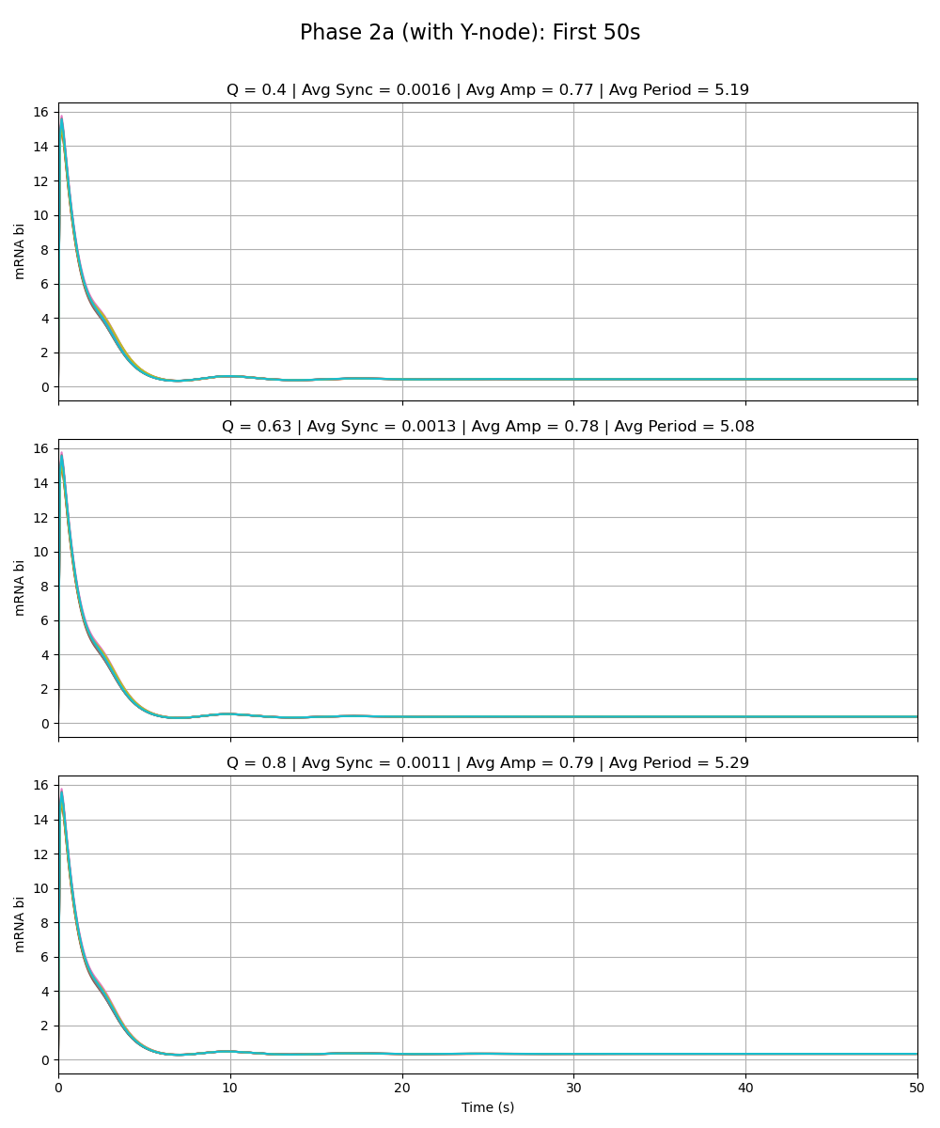
Equal Strength Added Node
Notes:
Phase 2a – added link is same strength as the rest of the circuit (max rate of y transcription is 216 vs. max rate for the rest as given by paper 216)

Slide 20
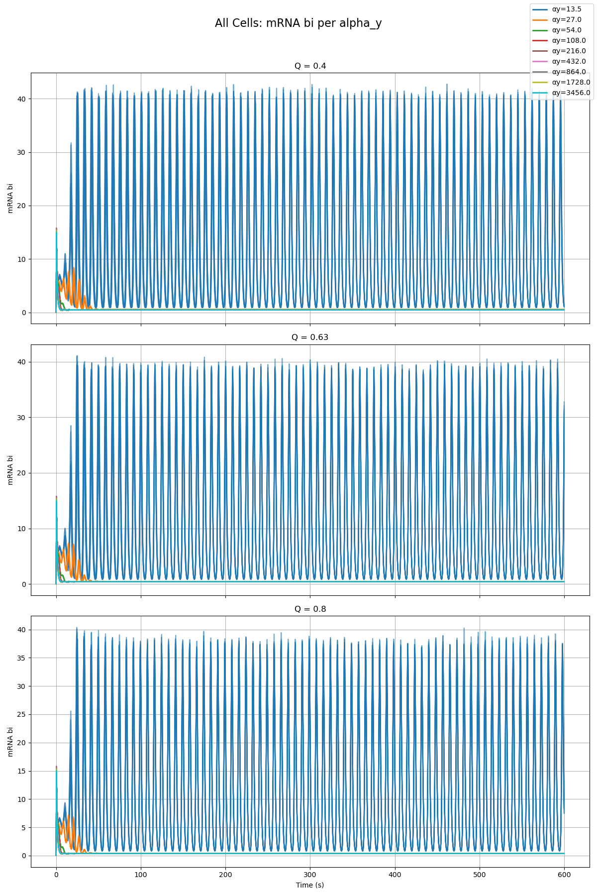
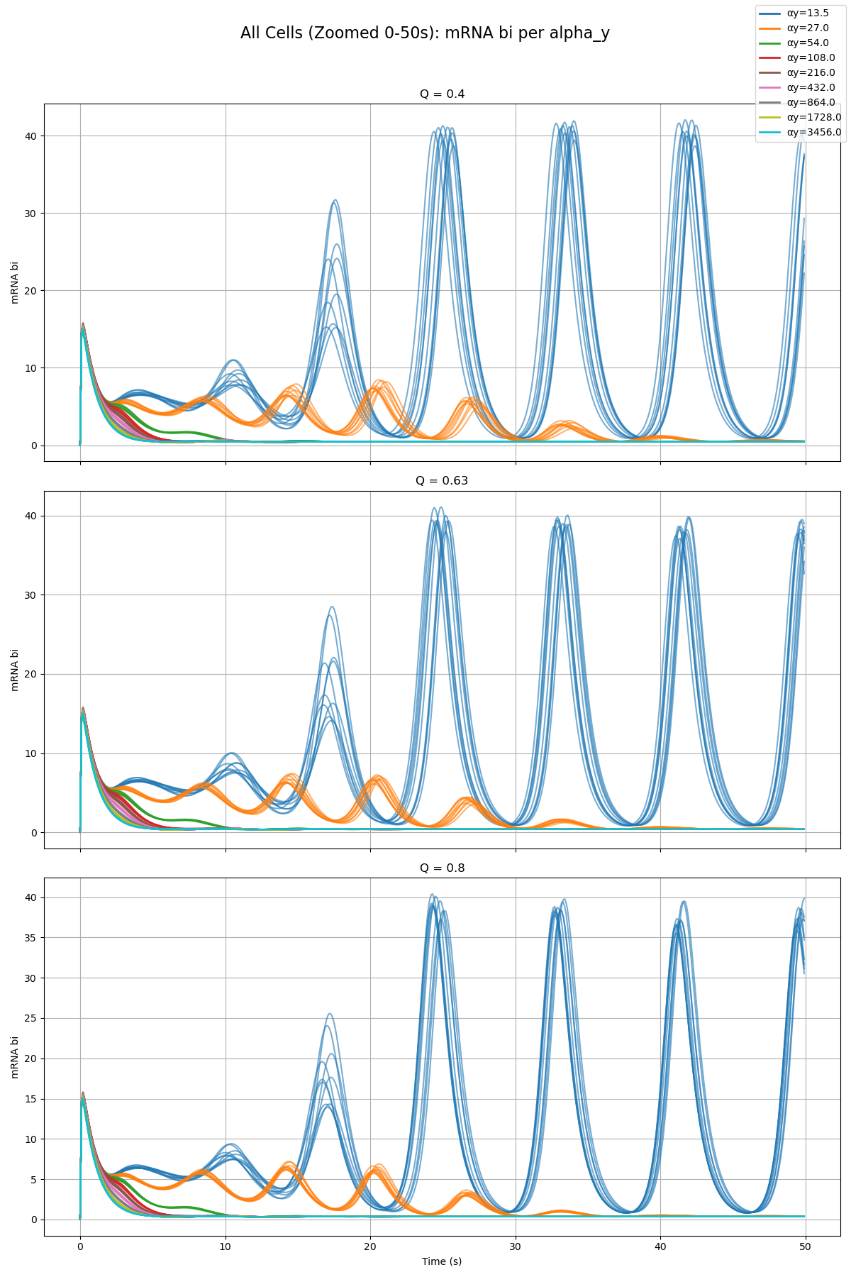
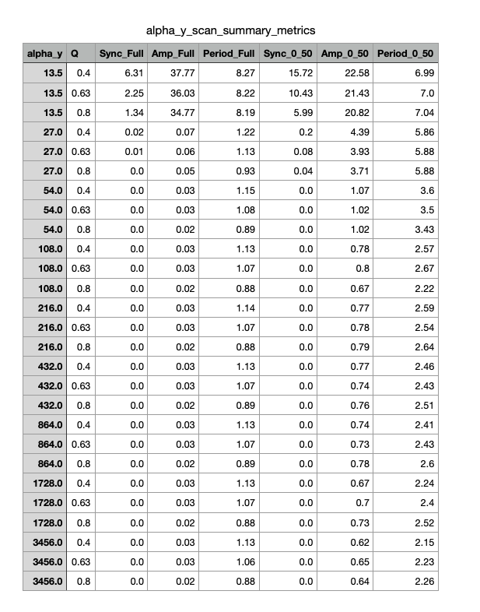
Parameter Scan

Slide 21
Phase 2a – Node Z
Olivia

Slide 22

Weak Added Node
Notes:
Phase 2a – added link is very weak (max rate of z transcription is very low 0.01 vs. max rate for the rest as given by paper 216)

Slide 23
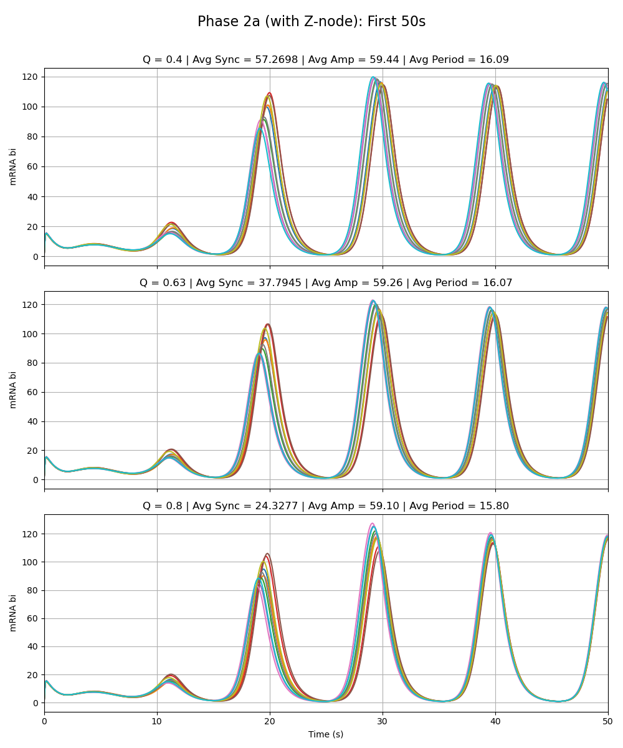
Weak Added Node
Notes:
Phase 2a – added link is very weak (max rate of z transcription is very low 0.01 vs. max rate for the rest as given by paper 216)

Slide 24
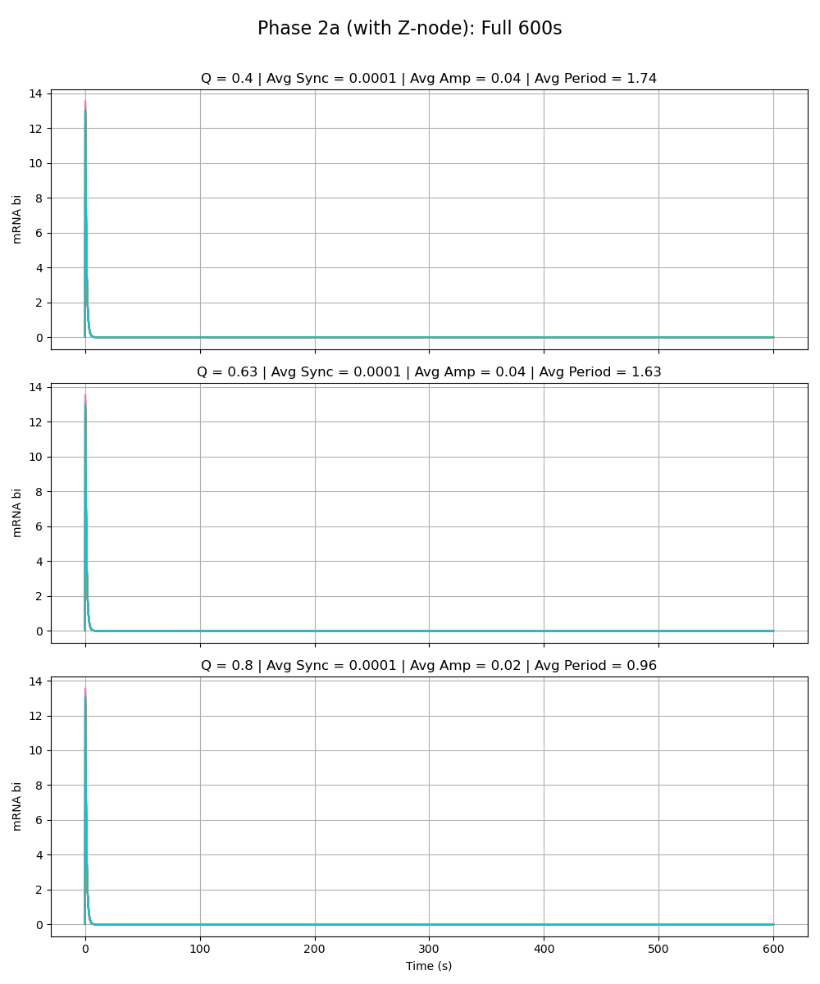
Equal Strength Added Node
Notes:
Phase 2a – added link is same strength as the rest of the circuit (max rate of z transcription is 216 vs. max rate for the rest as given by paper 216)

Slide 25
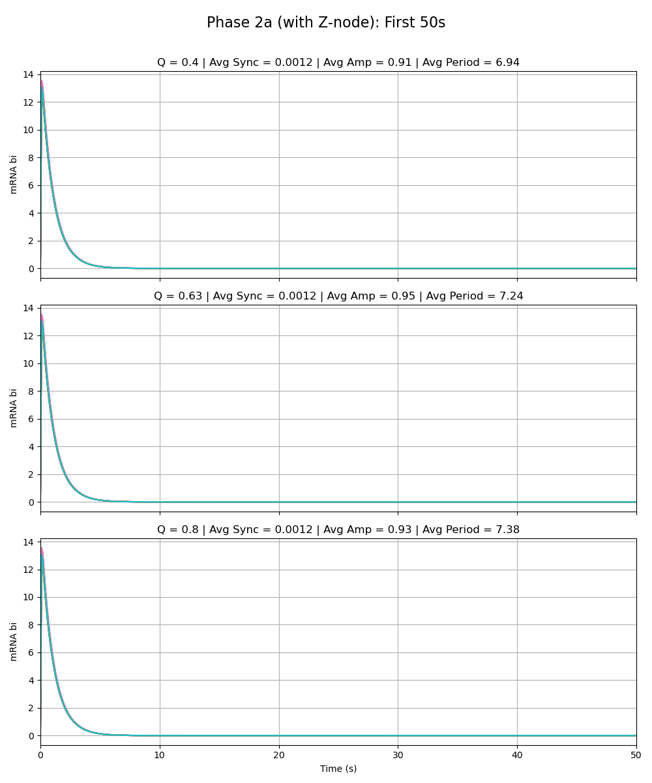
Equal Strength Added Node
Notes:
Phase 2a – added link is same strength as the rest of the circuit (max rate of z transcription is 216 vs. max rate for the rest as given by paper 216)

Slide 26
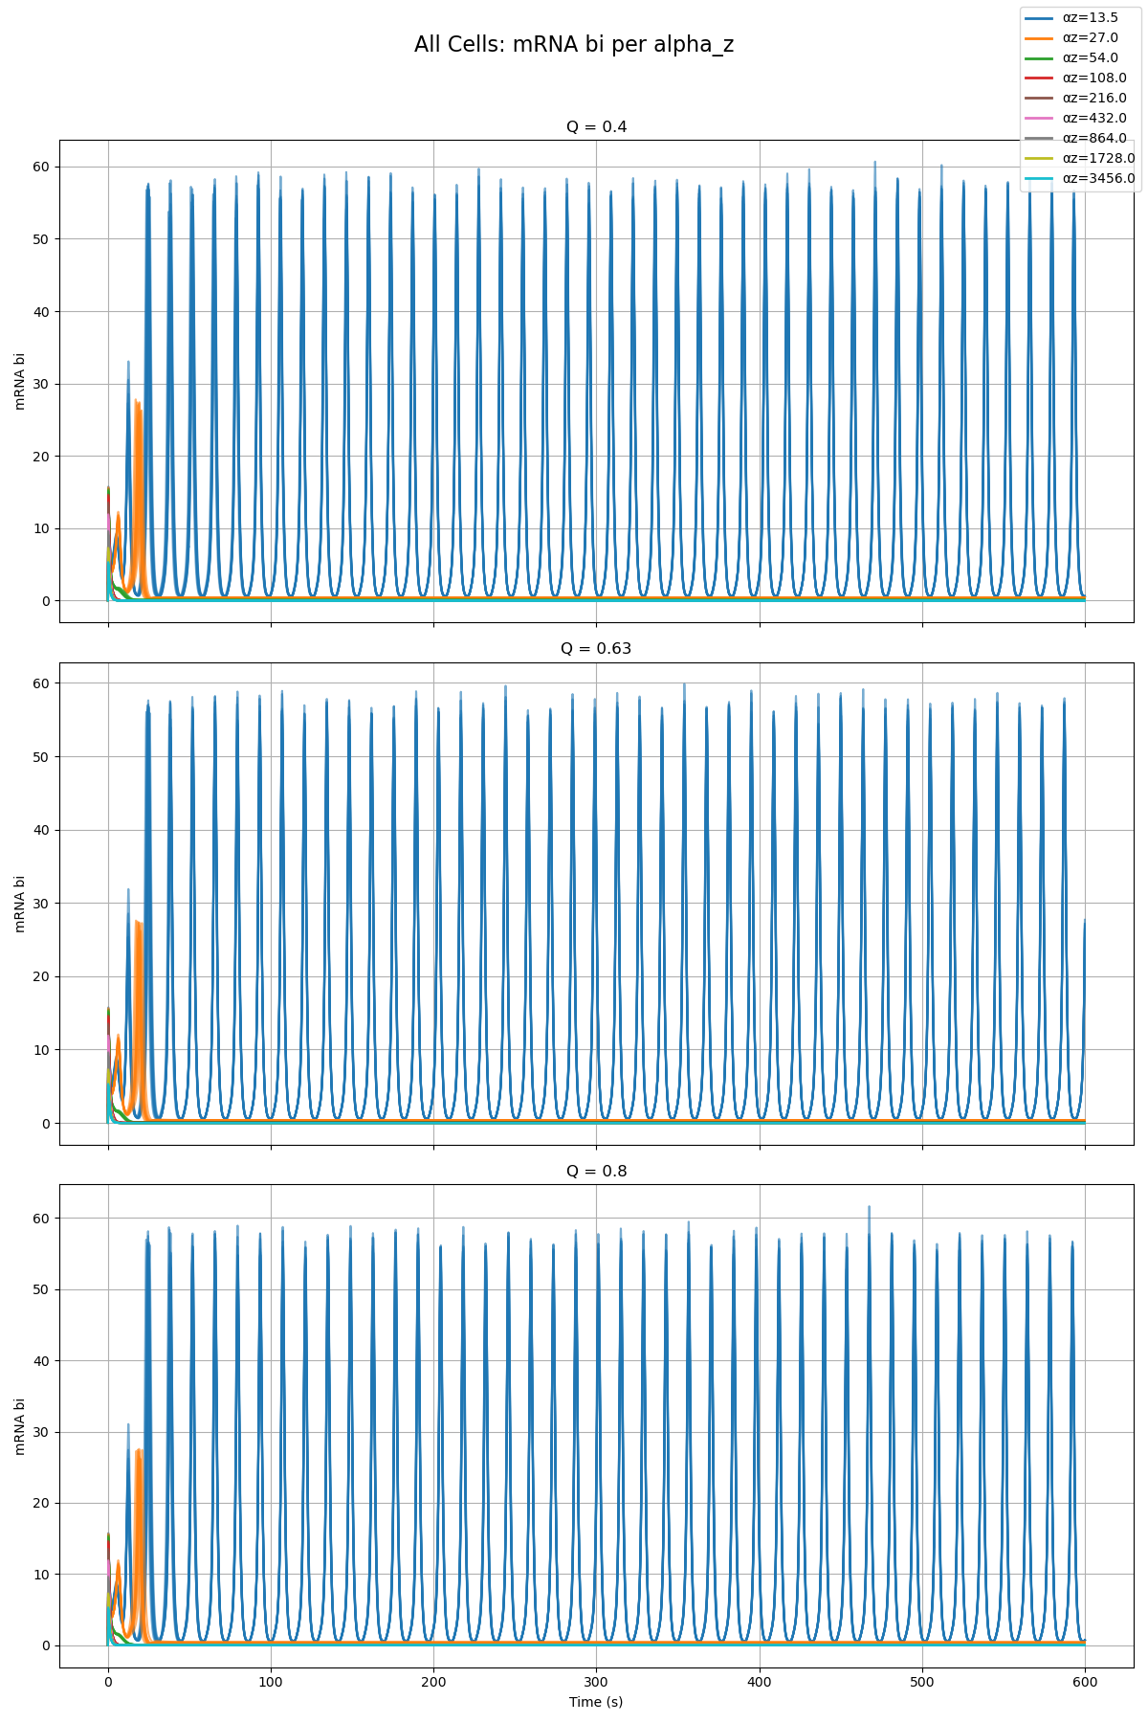
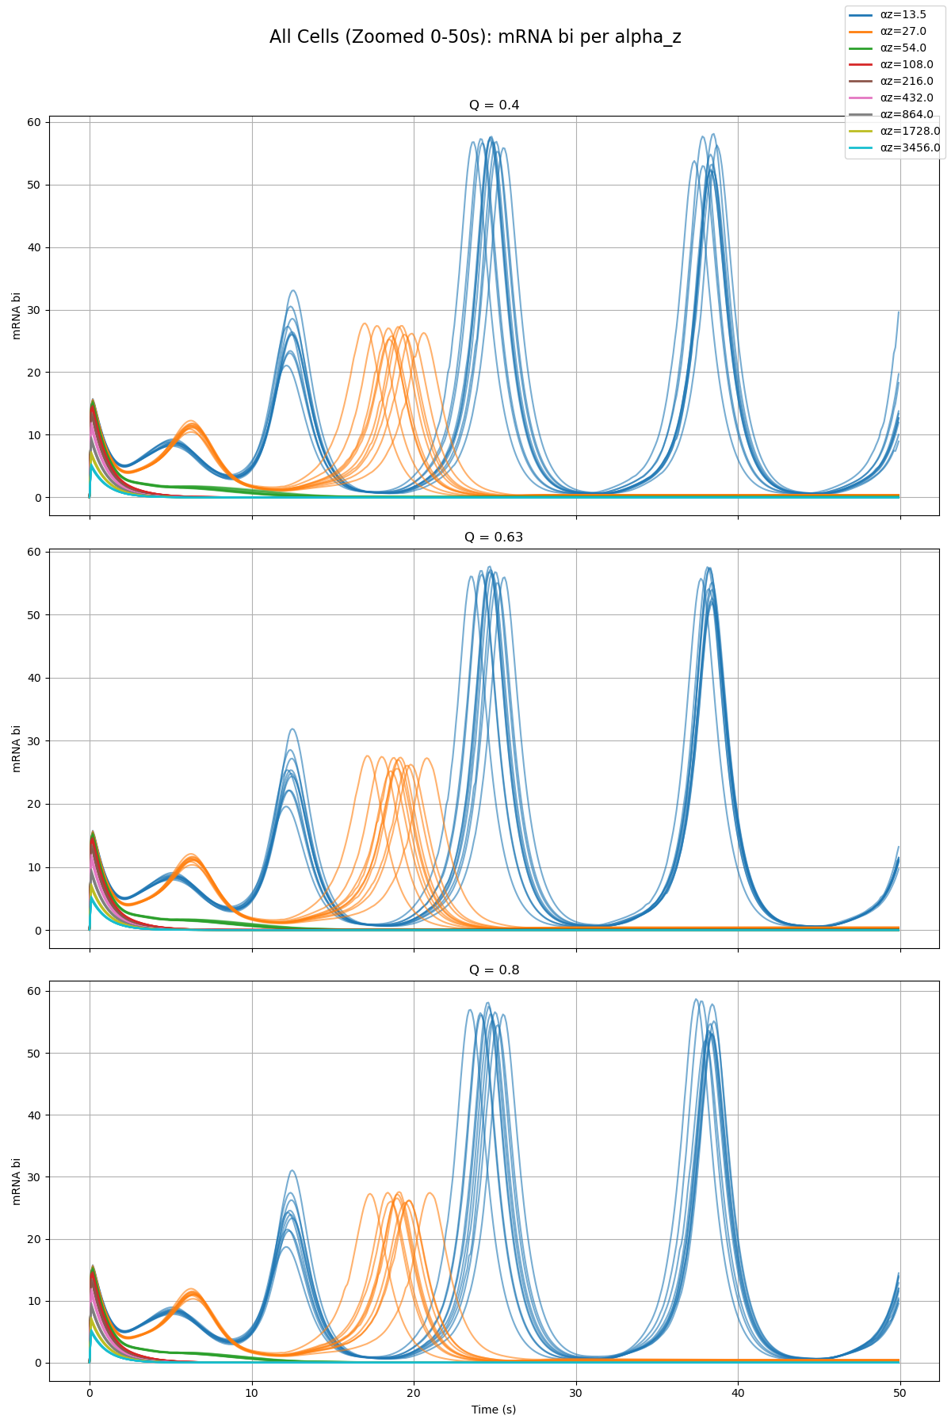
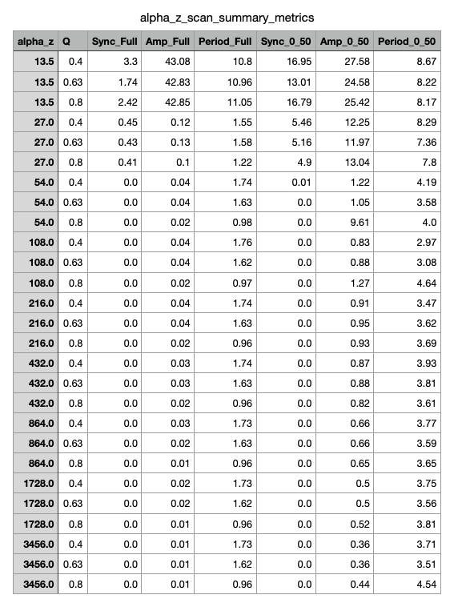
Parameter Scan

Slide 27
Phase 2b – Group Model

Slide 28
Paper Model vs. Group Model Alpha_W = 0.01 Alpha_X = 0.01 Alpha_Y = 0.01 Alpha_Z = 0.01

Slide 29
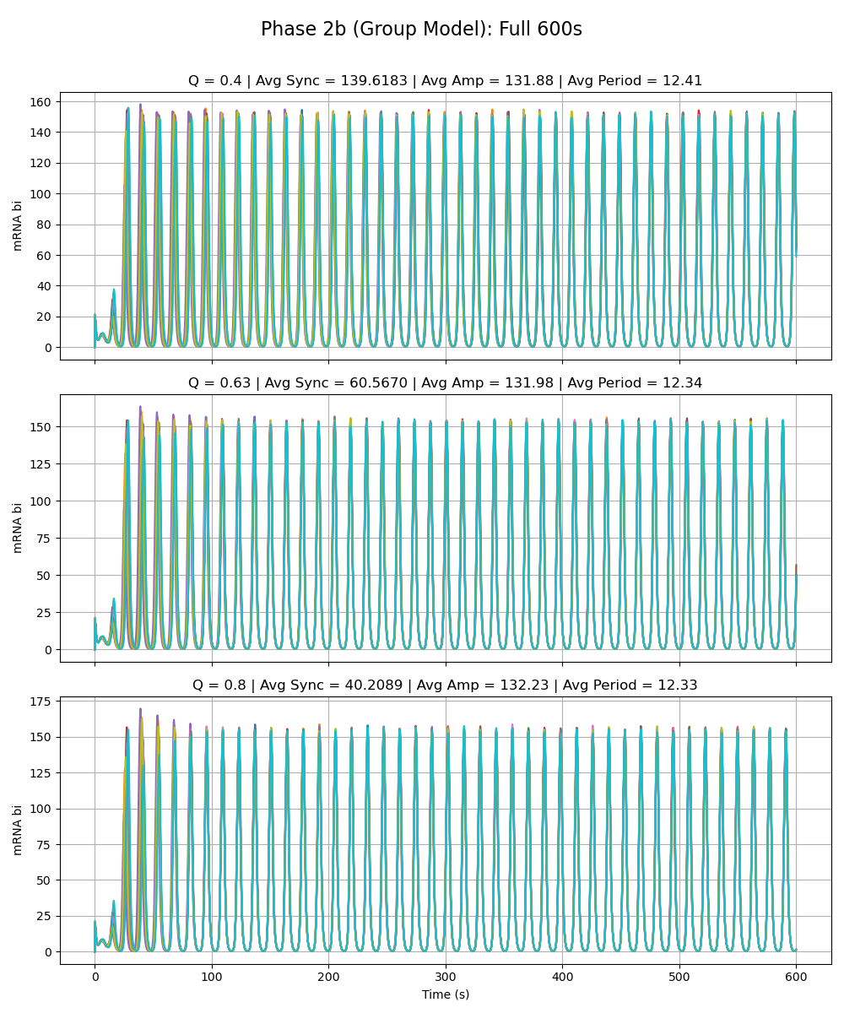
Notes:
All special alphas are 0.01

Slide 30
Adriana Phase 2a Model vs. Group Model Alpha_W = 216 Alpha_X = 0.01 Alpha_Y = 0.01 Alpha_Z = 0.01

Slide 31
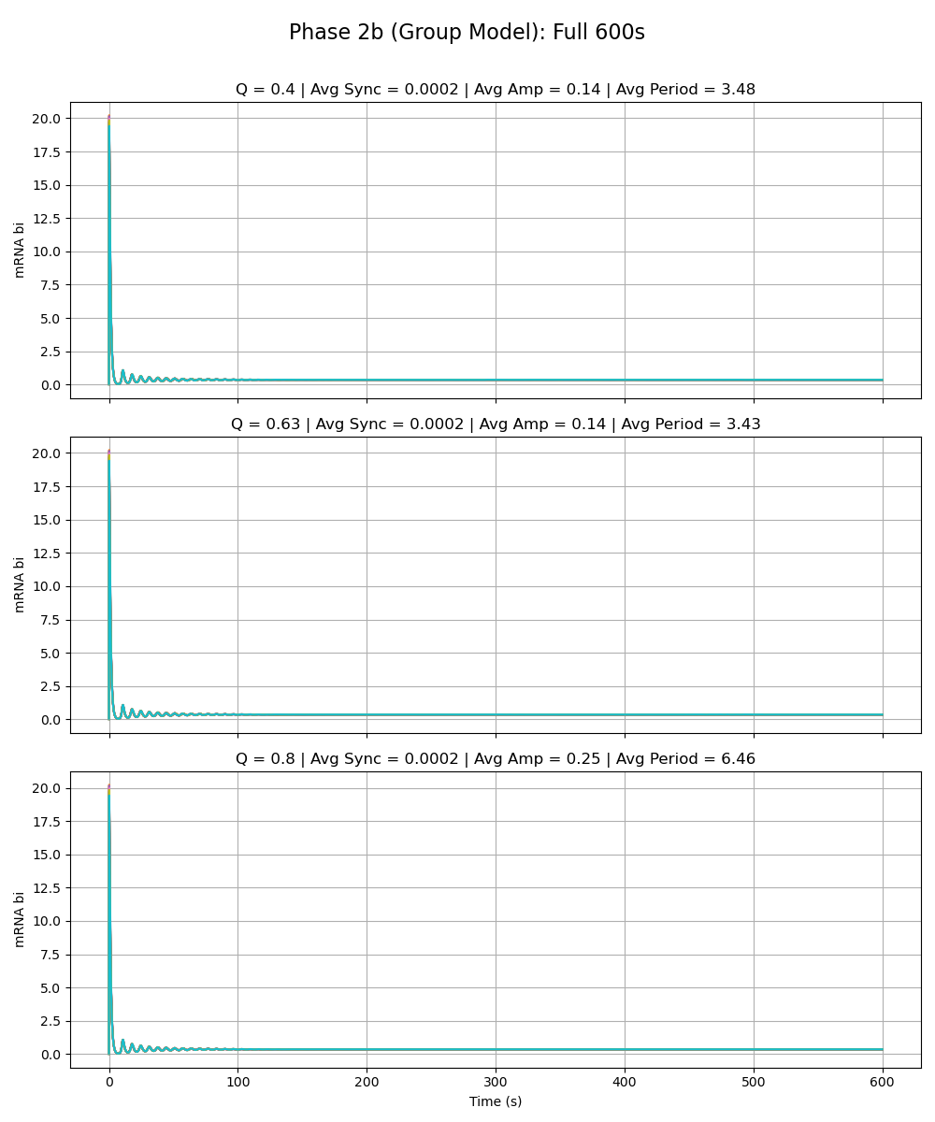
Notes:
alpha_w is 216

Slide 32
Sydney Phase 2a Model vs. Group Model Alpha_W = 0.01 Alpha_X = 216 Alpha_Y = 0.01 Alpha_Z = 0.01

Slide 33
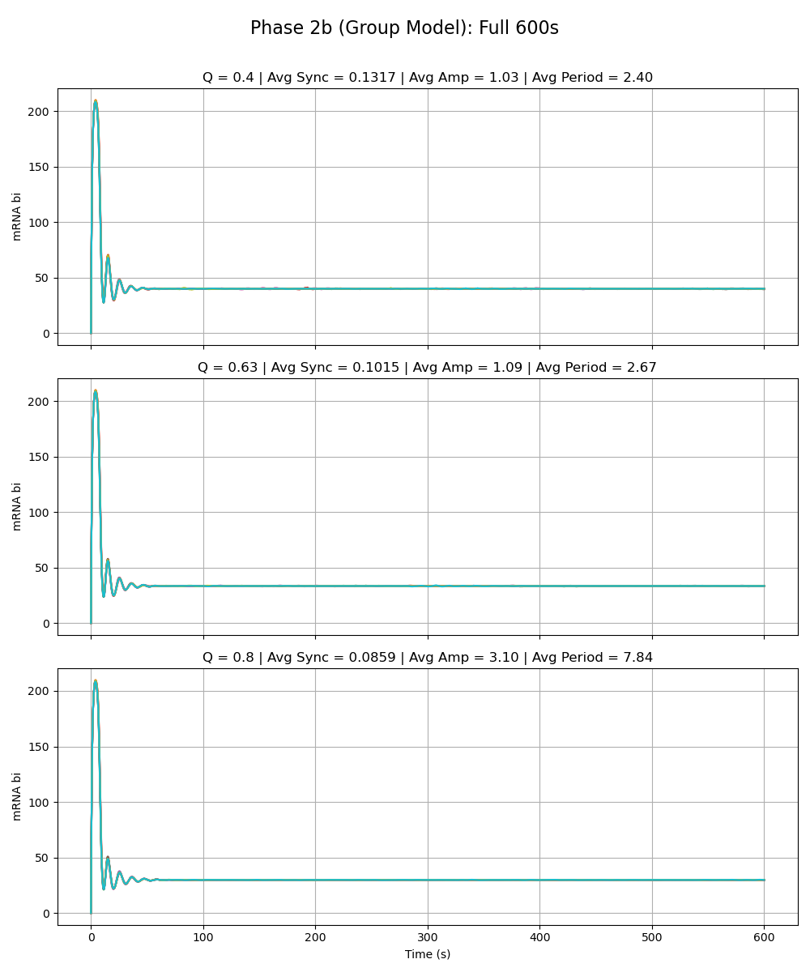
Notes:
alpha_x is 216

Slide 34
Sean Phase 2a Model vs. Group Model Alpha_W = 0.01 Alpha_X = 0.01 Alpha_Y = 216 Alpha_Z = 0.01

Slide 35
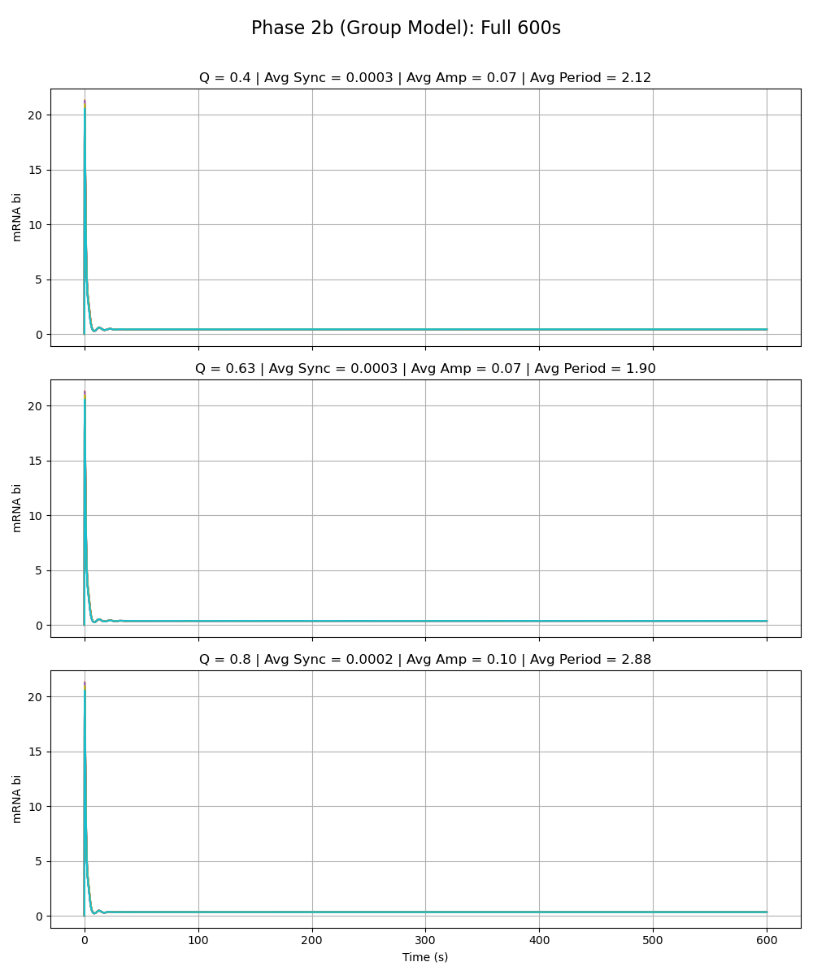
Notes:
alpha_y is 216

Slide 36
Olivia Phase 2a Model vs. Group Model Alpha_W = 0.01 Alpha_X = 0.01 Alpha_Y = 0.01 Alpha_Z = 216

Slide 37
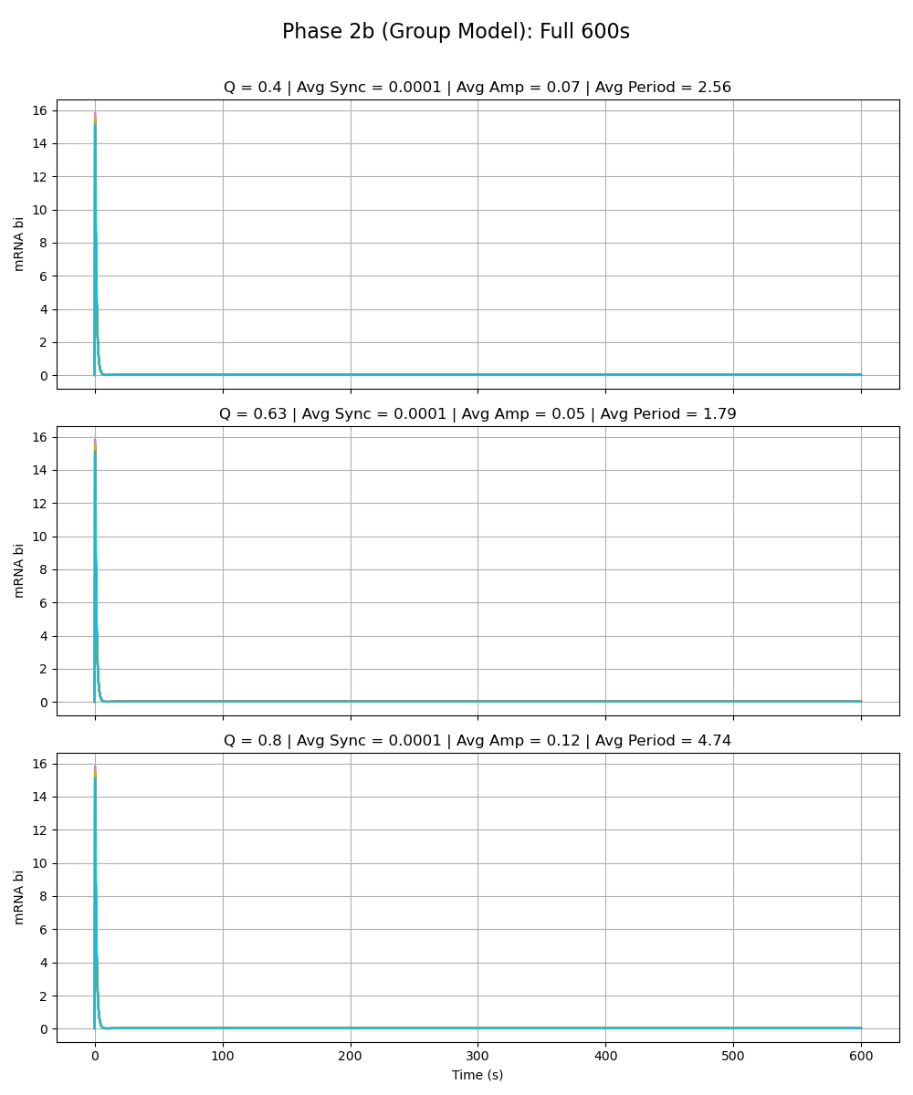
Notes:
alpha_z is 216

Slide 38
Paper Model vs. Group Model Alpha_W = 0.01 Alpha_X = 0.01 Alpha_Y = 0.01 Alpha_Z = 0.01

Slide 39
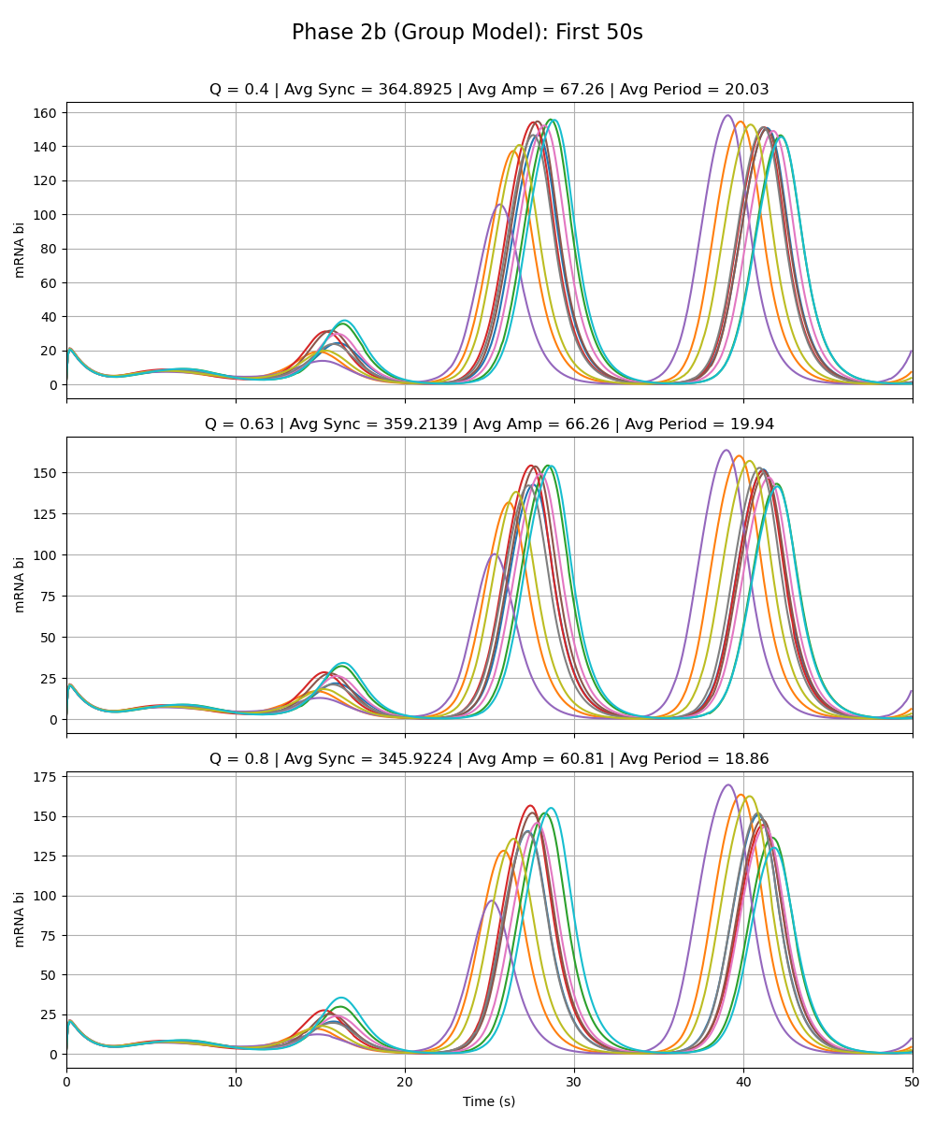
Notes:
All special alphas are 0.01

Slide 40
Adriana Phase 2a Model vs. Group Model Alpha_W = 216 Alpha_X = 0.01 Alpha_Y = 0.01 Alpha_Z = 0.01

Slide 41
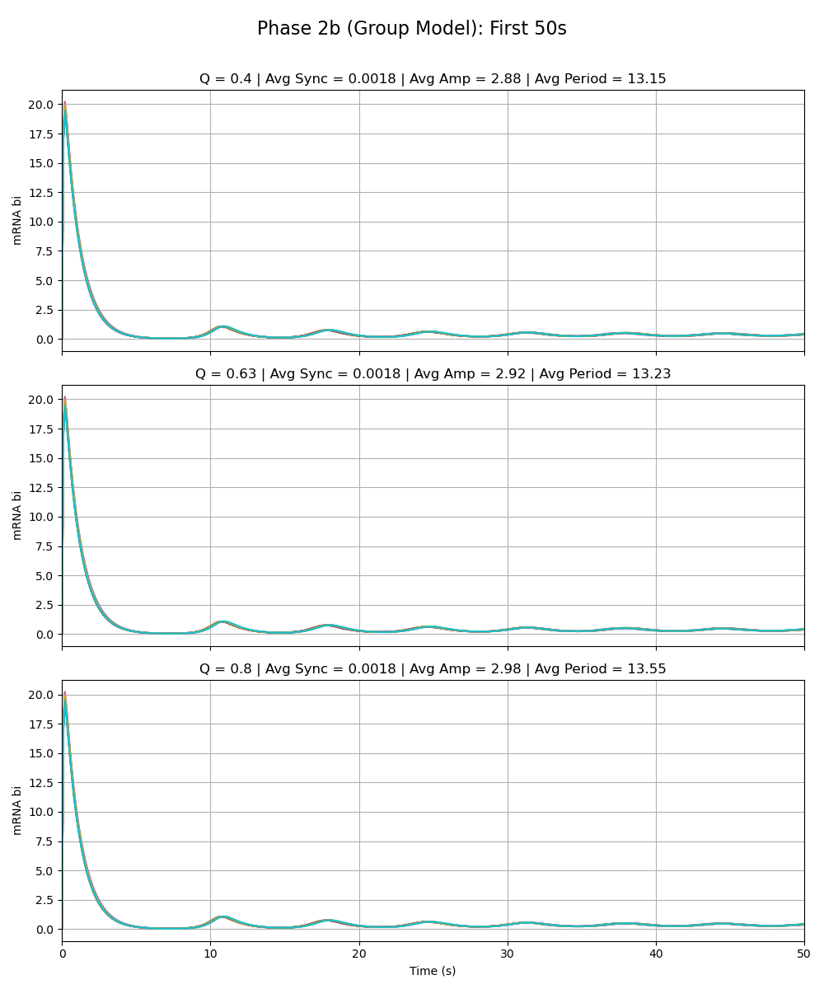
Notes:
alpha_w is 216

Slide 42
Sydney Phase 2a Model vs. Group Model Alpha_W = 0.01 Alpha_X = 216 Alpha_Y = 0.01 Alpha_Z = 0.01

Slide 43
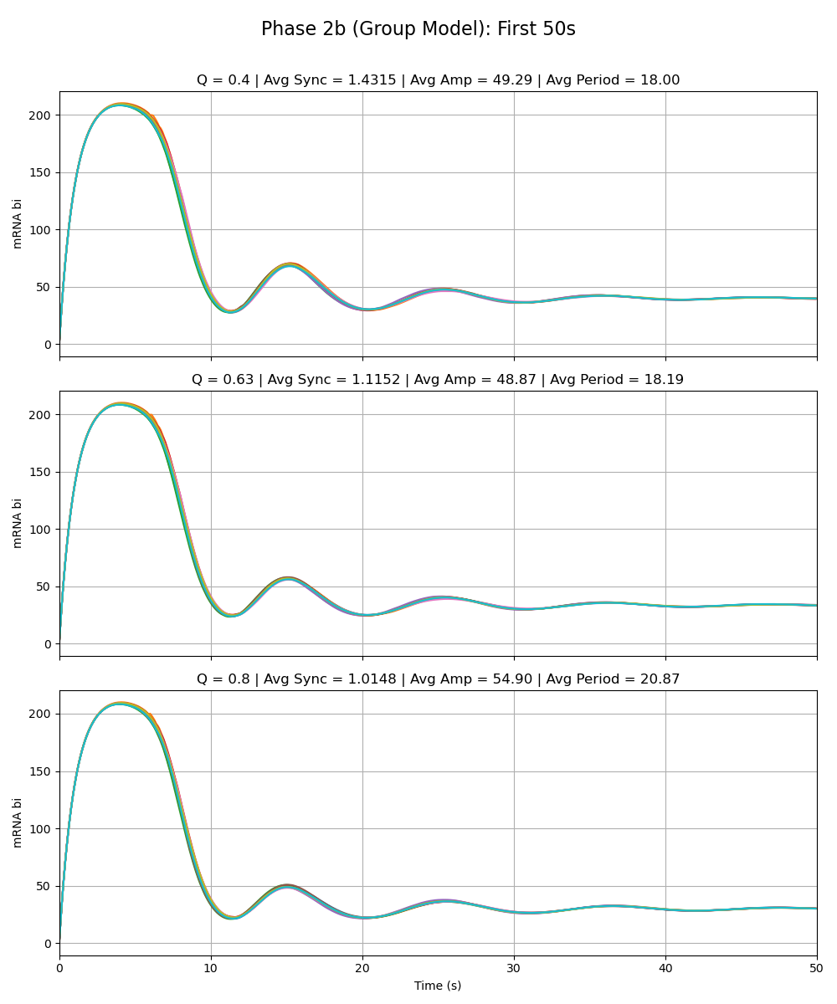
Notes:
alpha_x is 216

Slide 44
Sean Phase 2a Model vs. Group Model Alpha_W = 0.01 Alpha_X = 0.01 Alpha_Y = 216 Alpha_Z = 0.01

Slide 45
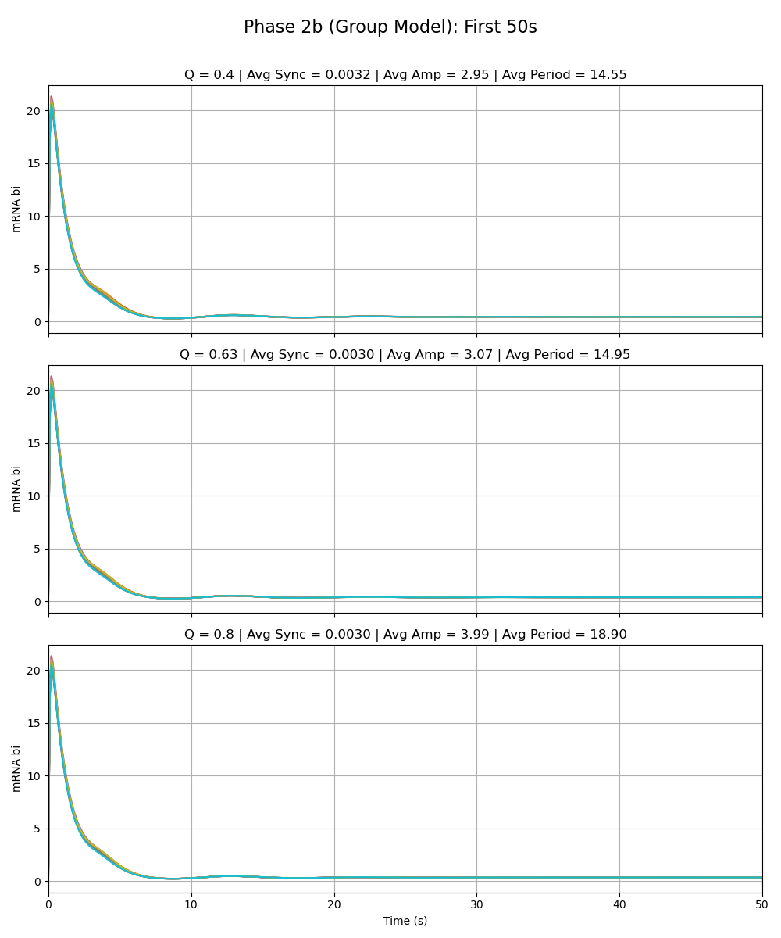
Notes:
alpha_y is 216

Slide 46
Olivia Phase 2a Model vs. Group Model Alpha_W = 0.01 Alpha_X = 0.01 Alpha_Y = 0.01 Alpha_Z = 216

Slide 47
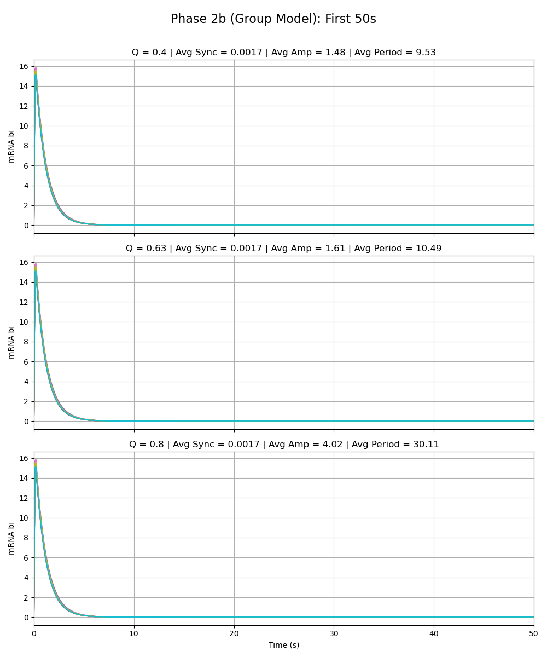
Notes:
alpha_z is 216

